Slide 1

Topic: Rational Numbers EQ: What do I need in order to add and subtract rational numbers?

Slide 2

Warm up
Find a the missing numbers
What is the lowest common multiple of:
2
6
=
3 and 4
12
5
15
5 and 6
30
3
15
=
4 and 6
12
8
40
3 and 8
24
25
5
=
5 and 10
10
6
30

Slide 3

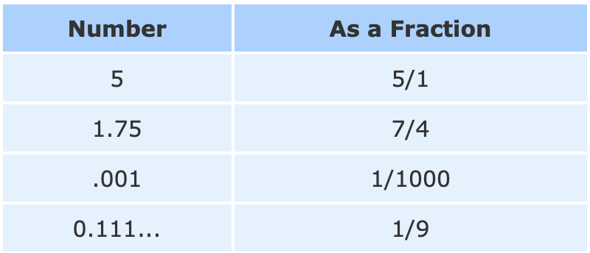

Rational Numbers
A rational number is a number that can be written as a simple fractions (i.e. as a ratio)
Ex:
In general, a rational number looks like this: $\frac{p}{q}$
But $q$ cannot be zero, as we can’t divide by zero

Slide 4
Adding and Subtracting Rational Numbers (Fractions)
The golden rule is this:
We can only add and subtract fractions that have the same denominator.
If two fractions don’t have the same denominator, we need to find the Lowest Common Multiple (LCM)

Slide 5
Same Denominator
Rule: If the denominator is the same, don’t change it. Keep it the same and simply add the numerators
1
3
1 + 3
4
+
=
=
5
5
5
5
One fifth
Three one fifths
1
3
1 + 3
4
+
=
=
5
5
5
5
One fifth
Three one fifths

Slide 6
Same Denominator Examples
2
7
+
3
7
=
5
7
2
9
+
4
9
=
6
9
5
11
-
3
11
=
2
11

Slide 7
Different Denominator
We need to make sure the denominator of both fractions is the same before we add or subtract
We need to LCM of 5 and 10?
5: 5, 10, 15
10, 10, 20,
2
5
+
3
10
=
4
10
+
3
10
=
7
10

Slide 8
Different Denominators
We need to make sure the denominator of both fractions is the same before we add or subtract
We need the LCM of 5 and 6
5: 5,10,15,20,25,30,35
6: 6,12,18,24, 30, 36
2
5
+
3
6
=
12
15
30
+
30
=
27
30

Slide 9
Different Denominators
We need to make sure the denominator of both fractions is the same before we add or subtract
We need to find the LCM of 8 and 3
8: 8,16,24,32
3: 3,6,9,12,15,18,21,24,27
7
8
-
2
3
=
21
16
24
-
24
=
5
24

Slide 10
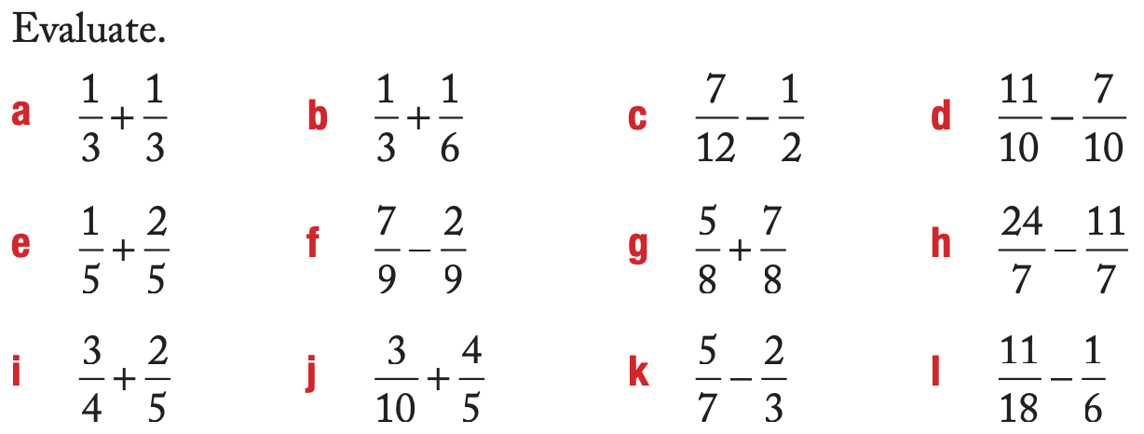
Your Turn

Slide 11
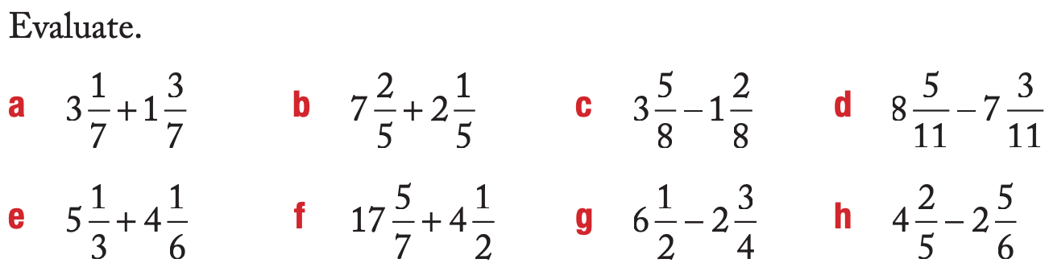
Extension

